Slide 1

Snap Finance Business Intelligence Assessment
By Sai Ajay Neelakandan
06/09/2025

Slide 2
Self Introduction
WHO IS SAI AJAY NEELAKANDAN

Slide 3
Objective
Analyze the dataset provided as part of Snap Finance’s BI Engineer assessment
Interpret the data as representative of Snap’s Lease-to-Own credit product
Evaluate customer behavior, campaign performance, and credit usage trends
Focus specifically on understanding credit utilization across marketing channels
Notes:
So, the main goal of this project was to analyze the dataset that Snap Finance provided as part of the BI Engineer take-home assessment.
After reviewing the data structure, I understood that the dataset as part of Snap’s Lease-to-Own credit offering or product.
While the business outcome was more task driven and not explicitly stated as a business problem, but I recognized and decided to focus the bulk of my analysis towards credit utilization across different marketing channels.

Slide 4
Approach
1. Choosing the Right Tools
Python : Jupyter Notebook – data cleaning, transformations, ETL logic
PostgreSQL – Metrics table and SQL view creation
Tableau – Interactive visualization and insight generation
GitHub – Version control and code repository
Notes:
Since Python was explicitly mentioned in the instructions, the meat of the project was carried out in Python using Jupyter Notebook.
Given the time constraint and the flexibility offered by the panel, I selected tools that I’m comfortable with.
That being said, I chose the ones that would allow me to work efficiently across different layers of the project.
As you can see the tools that I used were Python for Data Cleaning, transformations, ETL. PostgreSQL for Metrics table and View creation. Tableau for complex and interactive visualizations. Github for code repository.
I also took this as an opportunity to showcase my ability to integrate multiple tools at once to complete a BI project at a very short time, like in the real world scenario.

Slide 5

Approach
2. Understanding the Audience
Interview Panel
Marketing Stakeholders
Notes:
In the context of this assessment, the primary audience is the interview panel evaluating me for the BI Engineer role.
But if I think about this project as a real-world deliverable, the audience would likely be the marketing stakeholders who are likely trying to understand the performance of each marketing channel.

Slide 6

Approach
3. Focus on the Data
Cleaning the data - Cleaned the raw dataset and standardized key fields
Add metrics for calculation - Created new metrics to evaluate campaign and store performance
EDA - Conducted exploratory data analysis (EDA) to uncover patterns and provide GTM strategies
Notes:
Once the tools were in place and the audience understood, I focused on preparing the data to complete the tasks which in turn helped me answer my questions.
I started by cleaning the raw tables — ensuring that key fields like dates, flags, and numeric fields were consistent and usable. - COMPLETELY MADE USE OF PYTHON
Next, I created derived metrics — things like approval rates, percent of used credit, and dollars used per million dollars spent. In this process I created a metrics table and View
Finally, I performed a round of exploratory data analysis to identify interesting patterns
All of this was done with one focus: prepare the data to answer business questions clearly and confidently.

Slide 7
Approach
4. Focus on the Outcome
Data-driven business insights
Data Story Telling
Solutions driven GTM strategies

Slide 8

TASK – 1: Calculate the number of applications, number of approved, and the number of used applications and visualize the trend over the submission date.
Notes:
In Task 1, I was asked to calculate certain metrics like total number of applications, the number approved, and how many of those were actually used — and to visualize these trends over time using the submission date.
Instead of limiting the view to one fixed level of time which is date, I broke the trends down by day, month, quarter, and year.
This gave me broader perspective to analyze from; to see whether it's daily consistency, seasonal dips, or broader business cycles. It also made it easier to extract actionable insights and explain them to different levels of the business.

Slide 9
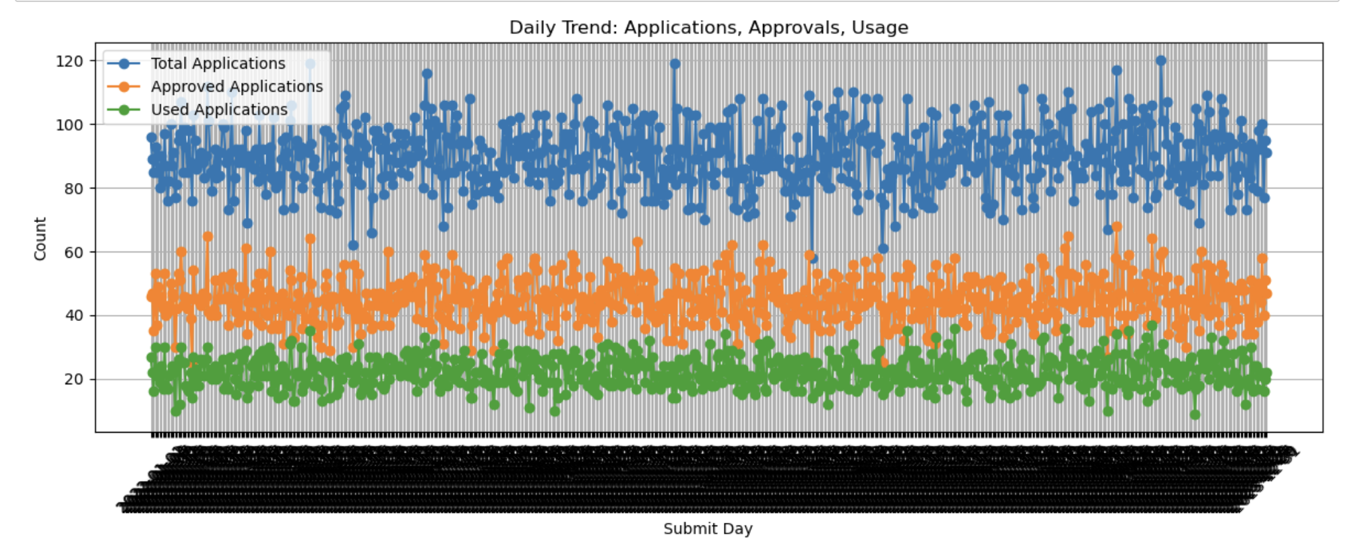
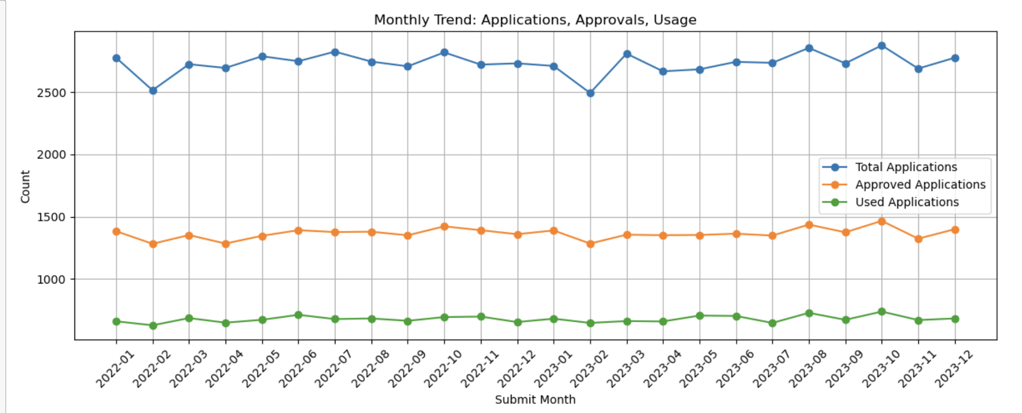
Visualizations
Metrics per submit day
Metrics per submit month
Notes:
All Metrics per submit day
All metrics per submit Month

Slide 10
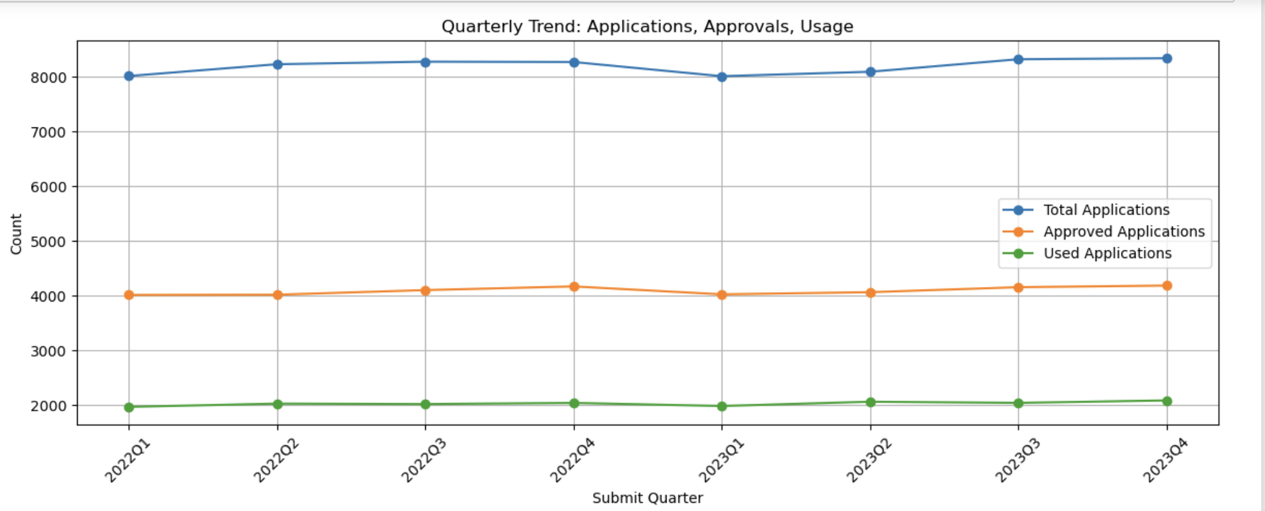
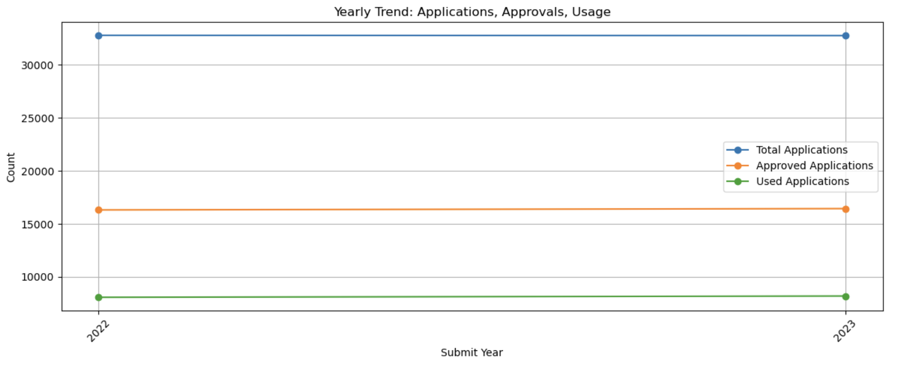
Visualizations
Metrics per submit Quarter
Metrics per submit year

Slide 11

What does the data have to say?
Daily Observations:
Applications ~90/day
Approval rate: ~50–60%
Usage ~20/day
Monthly Observations:
Applications dip in Dec–Jan, recover by Feb
Usage remains low and stable (~25% of total apps)
Quarterly & Yearly Trends
Seasonal dip reappears in Q1 across years
Usage rate does not significantly improve at higher time aggregation
Reinforces that usage gap is a recurring trend, not a short-term fluctuation
Notes:
DAILY
The daily trend is a bit noisy, but a few clear patterns emerge.
Applications raised are about 90 per day, which is positive.
Approvals on the other hand is only around 40 to 60 per day, which indicates a healthy and disciplined approval mechanism.
However, actual usage drops to around 20 per day, which indicates some loss in the funnel — not everyone who’s approved is using their credit.
MONTHLY
On a monthly view I could see/ sense seasonality. There’s a drop in applications during December and January and a bounce back starting February.
But once again usage rate remains flat throughout — just about 25% of applications.
QUARTERLY AND YEARLY
Both Quarterly and Yearly pretty much had similar observations with respect to seasonality dips and rise.

Slide 12
SO WHAT? IMPROVE GTM STRATEGY
Recommendation 1: Combat Year-End Drop
01
Launch “New Year Credit Push” in late December
Incentivize early credit activation
Example: Activate credit by Jan 15 – Earn $25 reward
Recommendation 2: Boost Post-Approval Usage
02
Add urgency with simple CTAs
Example: Use within 3 days – Unlock early usage perks
Notes:
JUST READ THE SLIDES

Slide 13
TASK – 2: Calculate the average of the approved amount and the average of the amount used and visualize the trend over the submission date.
Notes:
In Task 2 I was asked to calculate the average approved amount and the average amount actually used by customers — and to visualize how these trends change over time, again using the submission date.
Similar to Task 1, I chose to break down this analysis by day, month, quarter, and year to get a more complete view of the patterns

Slide 14
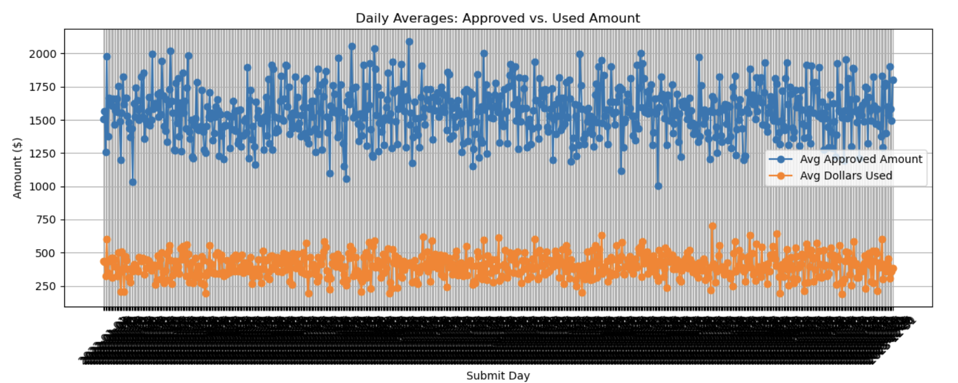
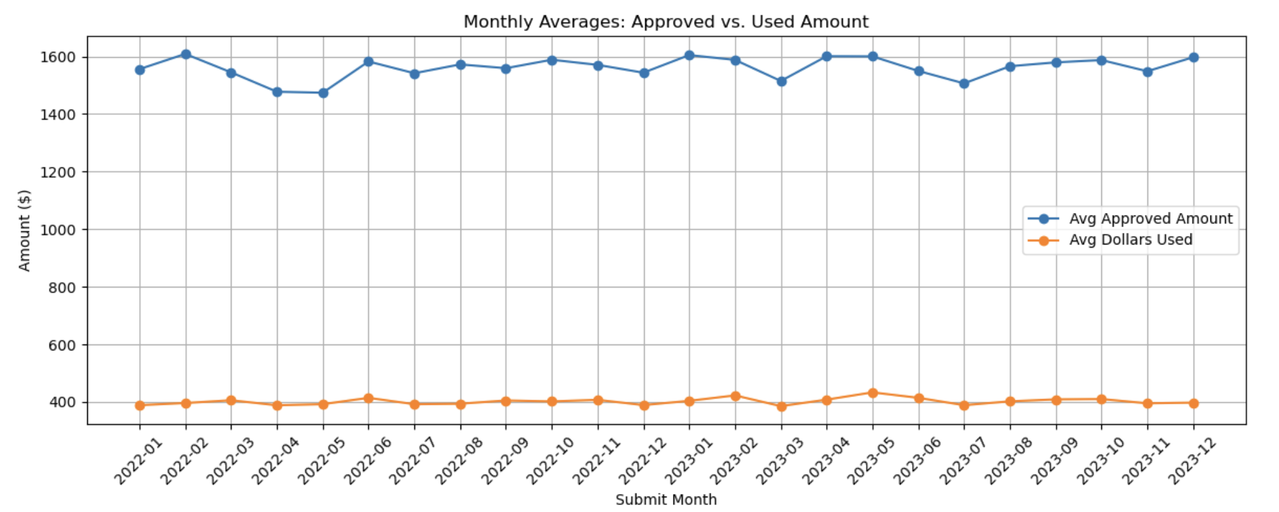
Visualizations
Metrics per submit day
Metrics per submit month

Slide 15
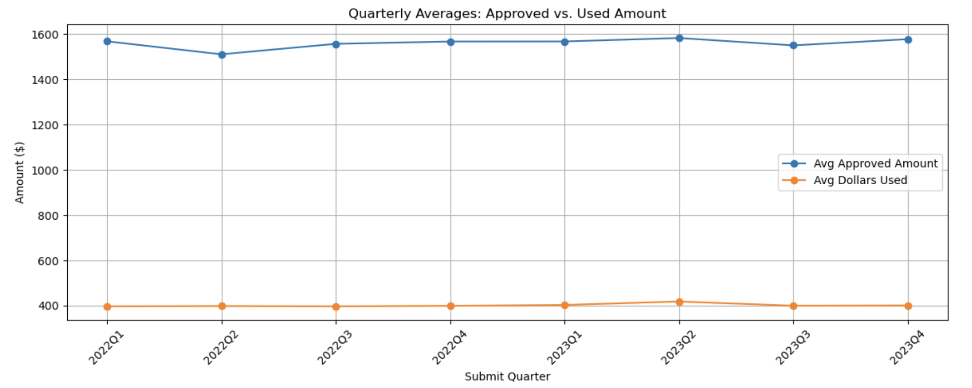
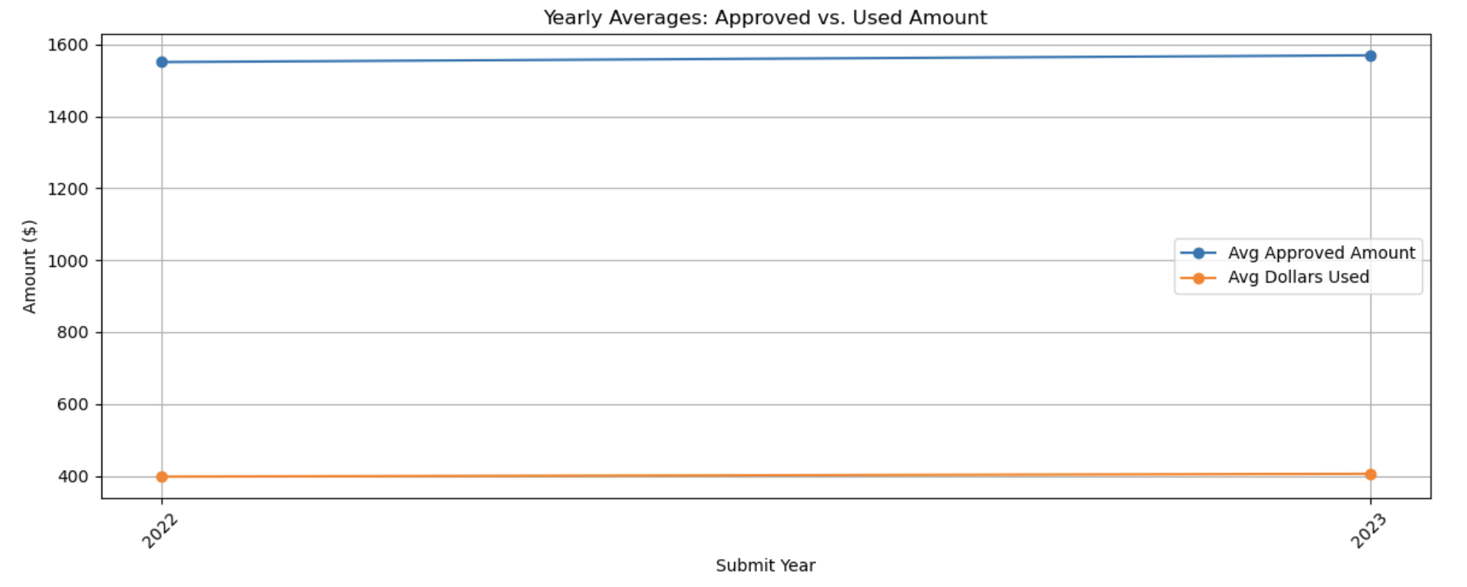
Visualizations
Metrics per submit quarter
Metrics per submit year
Notes:
NOW AS FAR AS THE INSIGHTS AND BUSINESS STRATEGIES ARE CONCERNED – SAME AS THE PREVIOUS TASK AS THE ONLY CHANGE HERE WAS THAT THE AGGREGATE USED WAS MEAN.

Slide 16
TASK – 3 : Create a table to show possible metrics (e.g. number of applications, number of approved, approved amount, number of used apps, used amount, percentages, etc) by store.
Notes:
In Task 3, I was asked to create a table that shows key metrics , all at the store level.
Since this involved working with structured data and calculating metrics across multiple related tables, I used PostgreSQL by pushing all cleaned data into the database and then built out the metrics directly using SQL - for two major reasons:
1. This approach more aligned with how similar work would be done in a real BI environment.
2. The resulting table was easy to be pushed into tableau for visualizations.

Slide 17
Metrics calculated
num_applications: Total number of applications submitted at the store
num_approved_applications: Count of applications that were approved
approval_rate: Percentage of applications approved
total_approved_amount: Sum of approved credit amount
total_used_amount: Total amount of credit actually used
percent_used_amount: % of approved amount that was actually used
num_used_applications: Count of approved applications that had any dollars used
Notes:
- These metrics were purposefully created with future visualizations kept in mind which helped me uncover some very interesting insights

Slide 18
TASK – 4 : Create a view with a graph to compare the used dollars amount by Marketing name, and color by spend amount.
Notes:
In Task 4, similar to task 3, I created a view with a bunch of metrics along with used dollars amount.
This view was then loaded into Tableau for visualization purposes

Slide 19
Metrics calculated
campaign: Campaign name
customers_per_campaign: Unique number of customers acquired through the campaign
applications_per_campaign: Total applications submitted from those customers
amount_spend_per_campaign: Total marketing spend for the campaign
percent_of_total_spend: campaign spend as a % of total spend
credit_approved_per_campaign: Total credit approved through to the customers obtained from a campaign
credit_approved_pct_of_total: credit approved as a % of total
credit_used_per_campaign: Total credit actually used by customers obtained from a campaign
credit_used_pct_of_total: total credit used from this campaign
credit_utilization_pct: % of approved credit that was actually used
spend_utilization_per_million: Dollars used per a million (in dollars) in marketing spend

Slide 20
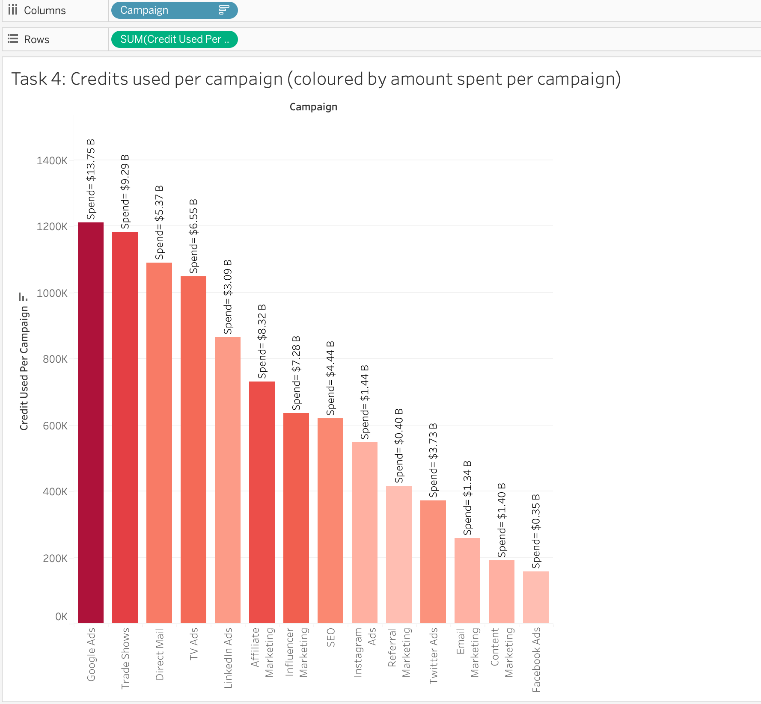
Visualizations
Notes:
First, the credits used per campaign along with the spend per campaign in Billion dollars.
We see here that google ads has the highest spend along with the highest credits usage.
But does this mean Google ads is a better campaign out of the rest, NO.
Because the measure is not a percentage value relative to the rest total spend and total usage amount.

Slide 21
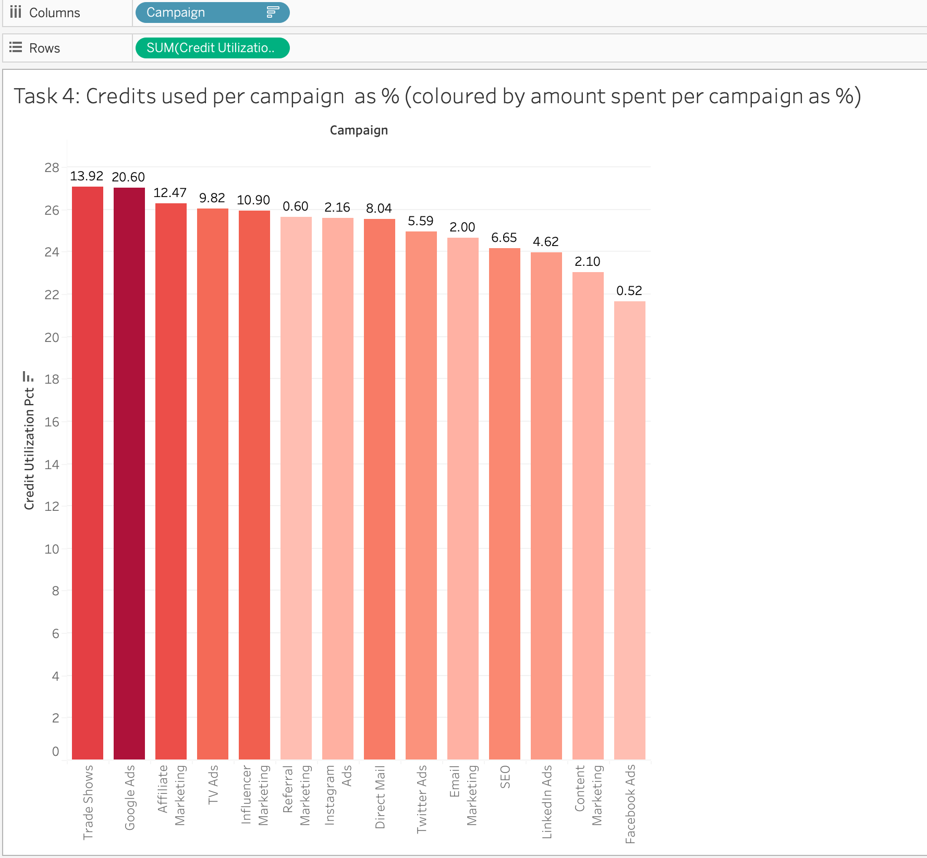
Visualizations
Notes:
To arrive at a solid understanding of what the data had to reveal, here's another viz with the variables in percentage

Slide 22
What does the data have to say?
Trade Shows stands out as the most effective marketing channel with highest total credit used, and at a slightly lesser spend that Google ads, indicating a strong utilization rate.
This suggests that budget allocated to Trade Shows is being converted into actual credit usage more efficiently than any other channel.
Notes:
READ THE SLIDE

Slide 23
THE FINAL TASK : Produce something interesting
Notes:
As part of task 5 I came with some interesting Visualizations out of the metrics calculated in the Store Metrics Table and Marketing metrics view
I made use of tableau to achieve this task .
This was the most challenging task because I did not have a business problem laid out in front of me.
I therefore produced three pressing problems that I found were critical as far as the data is concerned.

Slide 24

Business Problem 1 -
Why is the utilization rate very low. Is their periodic drop off at different points in the financing funnel indicating poor validations across each stage?

Slide 25
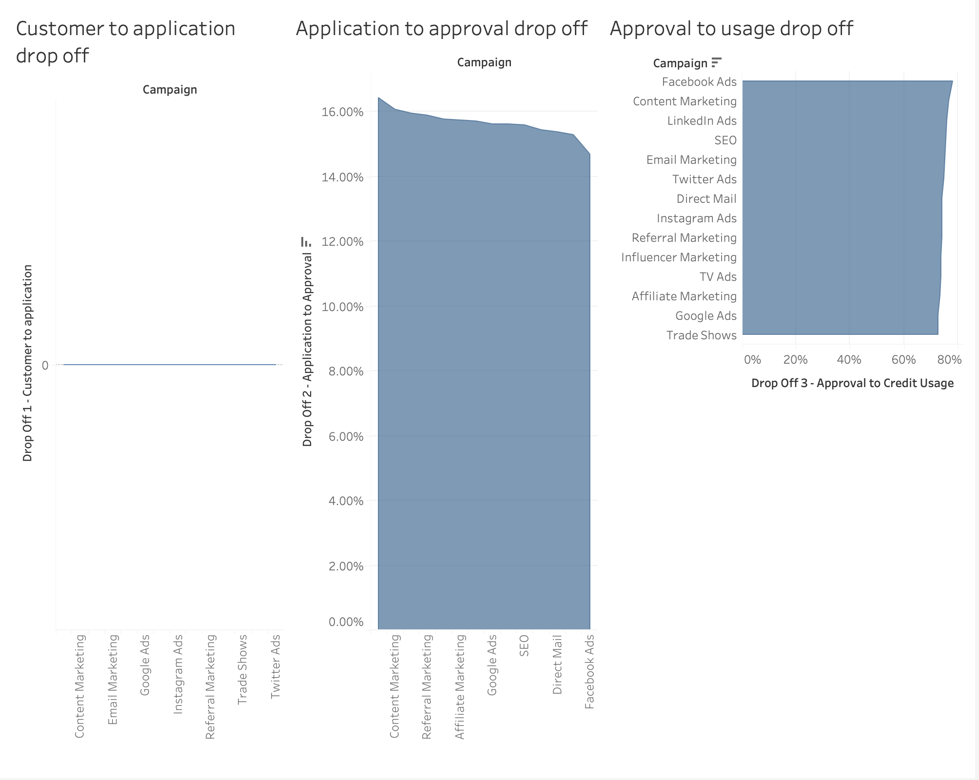
What does this visualization have to say?
Notes:
I tried analyzing the drop off across three different stages
- Stage 1: Customer → Application
There was almost no drop-off here. Most customers who were acquired actually went on to submit an application.
- Stage 2: Application → Approval
I saw a small drop-off here (~15%). This means most applicants are getting approved. While that sounds great on the surface, some level of drop-off is healthy which indicates that the screening process in place.
- Stage 3: Approval → Usage
This is where we saw the biggest drop-off. About 25% of approved users didn’t use their credit. But what was interesting or a concern was that this pattern was similar across most campaigns.

Slide 26
SO, WHAT’S THE RECOMMENDATION
Maintain filtering at each stage especially during approvals.
Don’t aim for 100% approval just to push volume.

Slide 27
Business Problem 2 -
While it's great that customers are being approved for credit, it was important to address high levels of unused approved credit which could mean customers aren’t following through, or even worse, the campaign isn’t attracting the right customers and Snap isn’t approving the right kind of users.

Slide 28
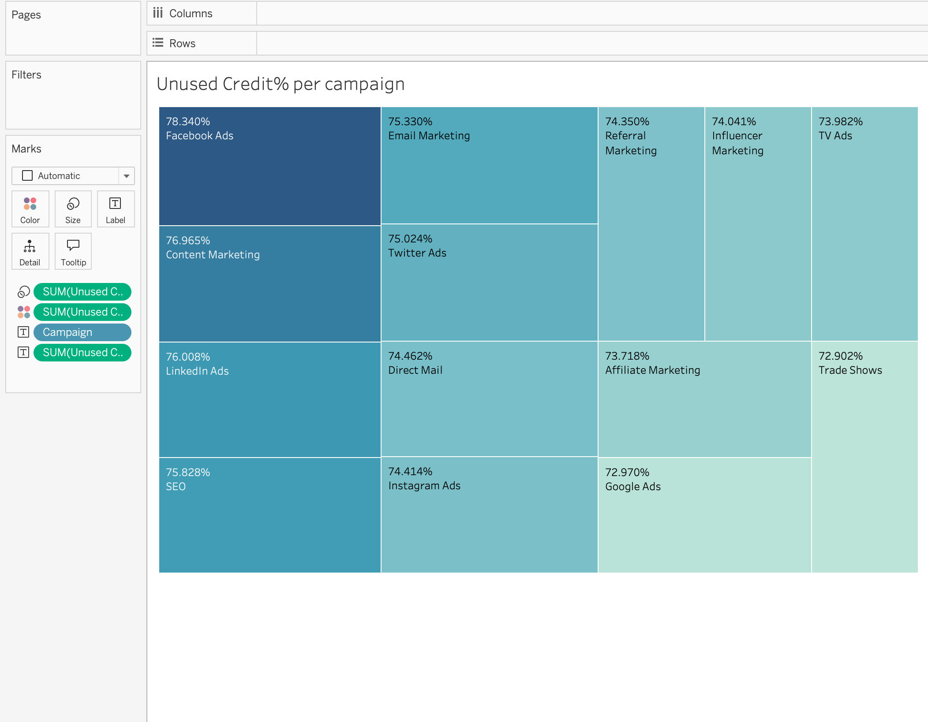
What does this visualization have to say?
Notes:
This treemap displays the percentage of approved credit that went unused, broken down by campaign.
- Across the board, every campaign had at least 70% of its approved credit go unused.
Facebook Ads had the highest unused credit % at 78.34%, followed closely by Email and Content Marketing.

Slide 29
SO, WHAT’S THE RECOMMENDATION
Introduce post-approval nudges: Send reminders, limited-time offers, or education on how to use approved credit
Add urgency post-approval: Try messaging like “Your credit is waiting – use within 7 days” to boost conversion

Slide 30
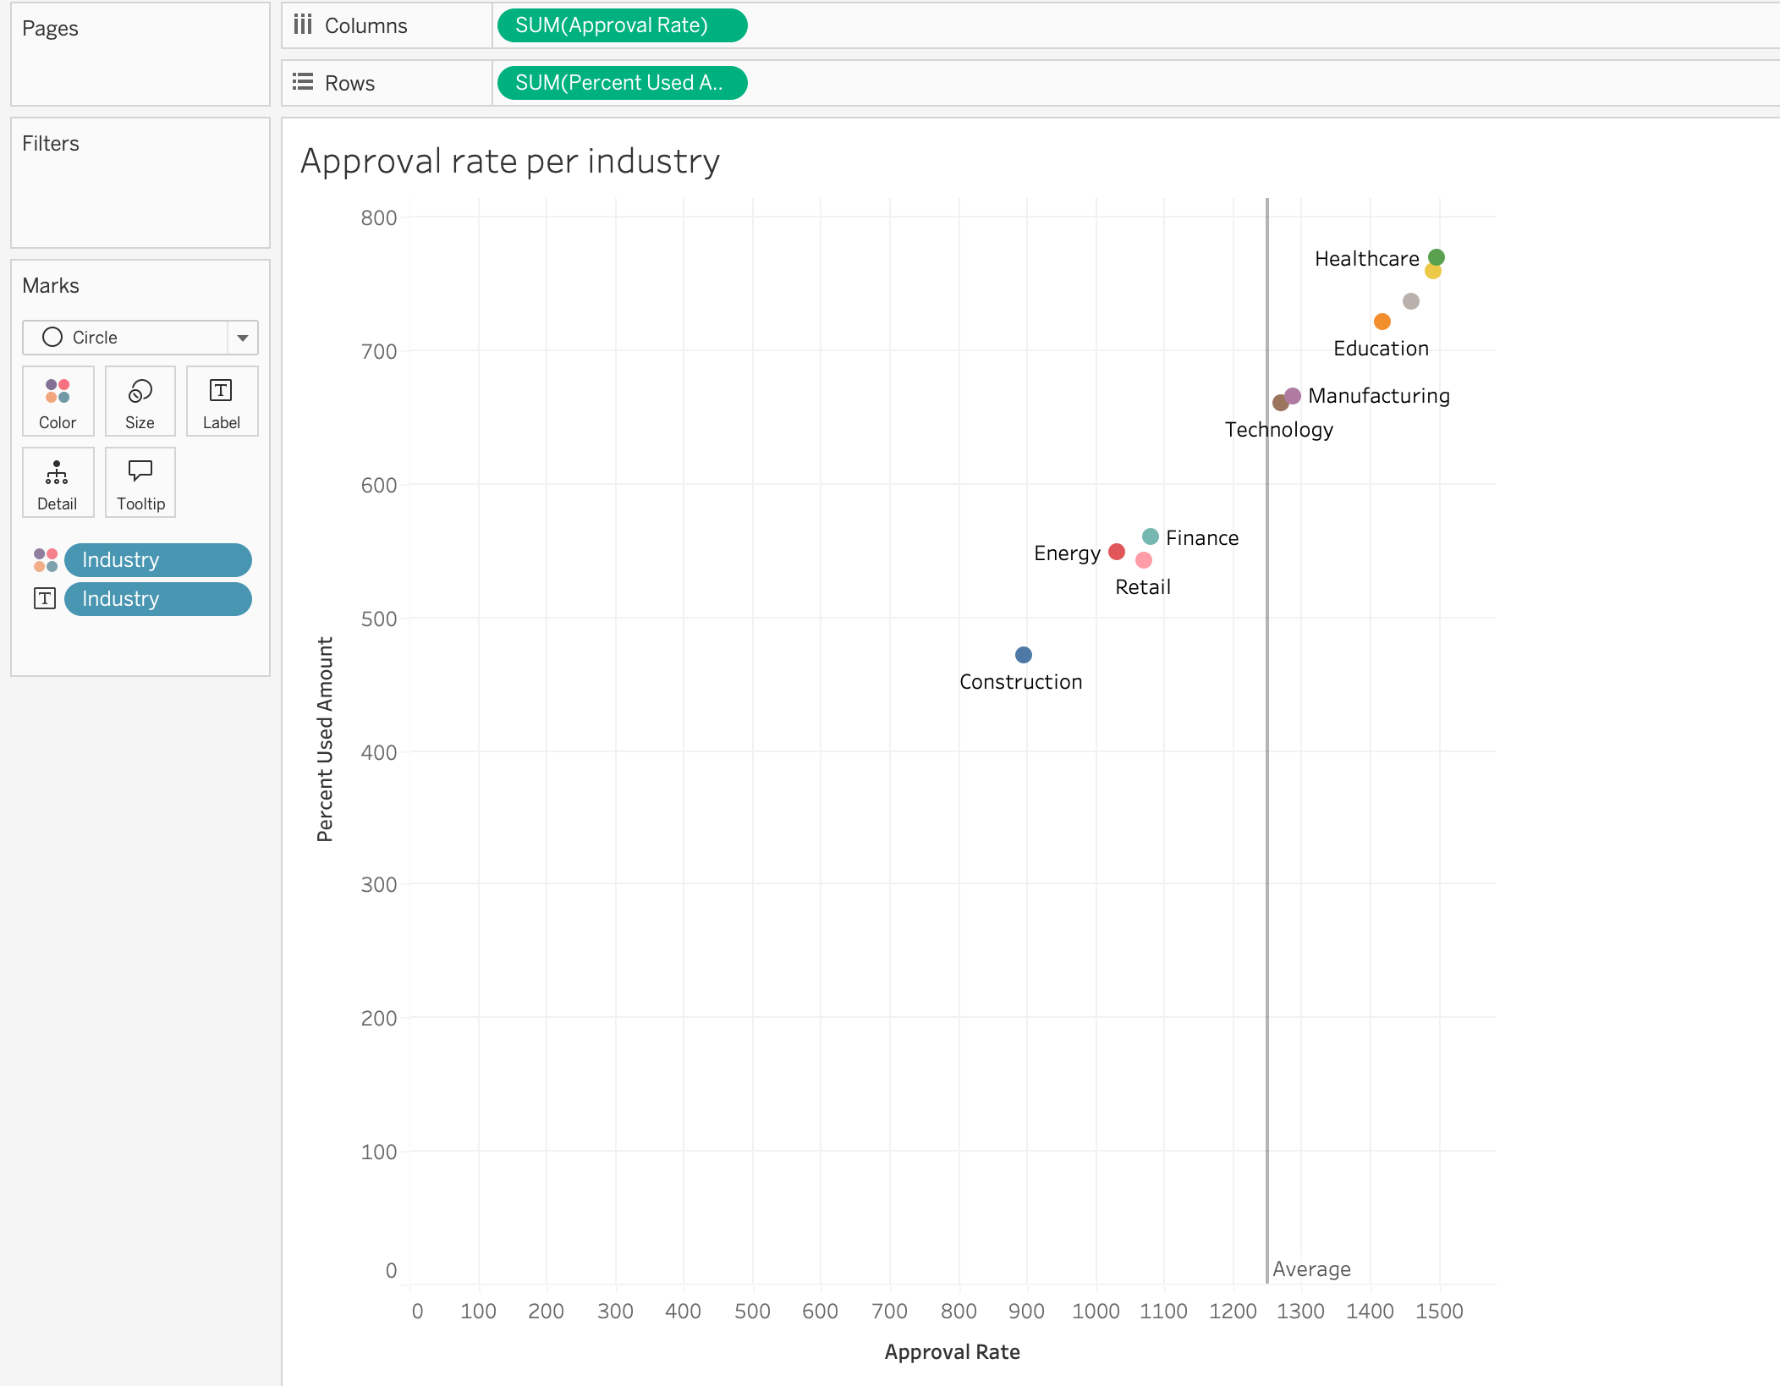
Bonus Insight – Unused credit at an industry level
Notes:
Industries like Healthcare and Education show a healthy balance — they approve a high number of applications, and most of that credit gets used.
However, industries such as Retail, Finance, and particularly Construction are clustered below the average in terms of usage, despite relatively high approval rates.

Slide 31

Technical Walkthrough

Slide 32
Reflection
What could have been better?
What are my Learnings?
Notes:
So, the main goal of this project was to analyze the dataset that Snap Finance provided as part of the BI Engineer take-home assessment.
After reviewing the data structure, I understood that the dataset as part of Snap’s Lease-to-Own credit offering or product.
While the business outcome was more task driven and not explicitly stated as a business problem, but I recognized and decided to focus the bulk of my analysis towards credit utilization across different marketing channels.

Slide 33

THANK YOU

